Slide 1

Hospital Management System using MySQL
Name: Kiruthik
Course: Data Science and ML with GenAI Advanced program
Date: 19-09-2025

Slide 2
Contents
Introduction
Objectives
Scope of the project
Database design
ER-Diagram
Advanced Features
Business requirements
Conclusion
Future scope

Slide 3
Introduction
The Hospital Management System (HMS) is a database project that is designed to manage all operations of a hospital digitally. It handles patients, doctors, appointments, prescriptions, billing, and pharmacy inventory. The goal is to provide a centralized database where staff can store, update, and retrieve data easily. Hospitals deal with huge data (patients, doctors, billing) in which manual records are error-prone.
So the system is designed to:
  Reduce manual paperwork.
  Improve patient care by centralizing information.
  Automate repetitive tasks (like billing, inventory, room allocation).
  Provide instant reporting and analytics for hospital administration.
Go to Contents

Slide 4
Objectives
Maintain accurate patient and doctor records.
Keeping track of prescriptions and medicines.
Generate billing details for patients.
Track appointments, admissions, and discharges.
Keep pharmacy and inventory up to date.
Automate tasks with procedures, triggers, events.
Ensure data security and prevent duplication.
Provide automation using triggers, procedures, and constraints.
Go to Contents

Slide 5
Scope of the Project
Patient Management – Registration, records, admissions, discharges.
Doctor & Staff Management – Profiles, schedules, role assignments.
Appointments & Admissions – Booking, scheduling, room allocation.
Prescriptions & Pharmacy – Digital prescriptions, medicine inventory, stock updates.
Billing & Payments – Automated bills, multiple payment modes, financial tracking.
Reports & Analytics – Medical, administrative, inventory, and revenue reports.
Security & Access Control – Role-based access, data privacy.
Future Enhancements – Telemedicine, device integration, AI support.
Go to Contents

Slide 6
Database Design
Entities:
Admissions - Manages patient admissions into the hospital.
Alerts - Stores system-generated alerts (e.g., critical vitals, medicine reminders).
Appointments - Links patients with doctors.
Billing - Stores billing information for each patient.
Diagnoses - Records diagnoses given to patients.
Medications - Manages information about medicines prescribed.
Patients – Stores patient details.
Pharmacy inventory - Maintains stock of medicines.
Prescriptions - Records prescribed medicines.
Rooms - Manages room allocation and availability in the hospital.
Staff - Stores doctor details and specialization.
Supply orders - Tracks orders of medical supplies/equipment.
Tests - Records diagnostic tests (e.g., lab tests, imaging).
Vitals - Stores patient vitals (e.g., blood pressure, temperature).
Go to Contents

Slide 7
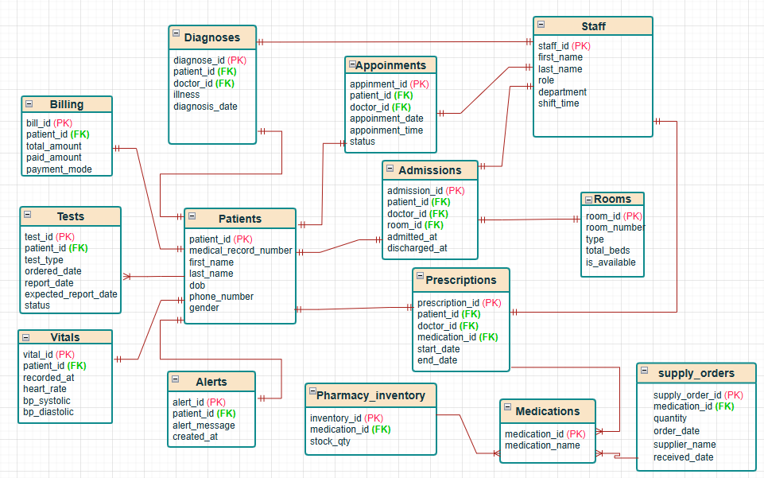
ER Diagram
Go to Contents

Slide 8
Advanced Features
Constraints:
  Primary Key → Uniqueness
  Foreign Key → Relationships
  Default → Pre-set values
  Check → Enforces rules (e.g., stock >= 0)
Indexes:
  Fasten query outputs
Security:
  Role-based access
Triggers:
  Update room status on admit/discharge.
  Deduct medicine stock when prescribed.
  Update billing when patient discharged.
  Notify doctor on critical vitals.
Procedures:
  Schedule appointment.
  Generate monthly reports.
Go to Contents

Slide 9
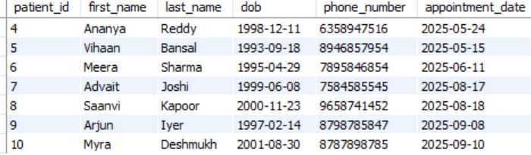
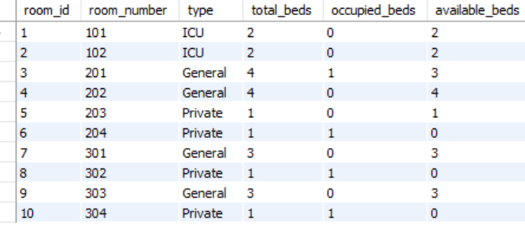
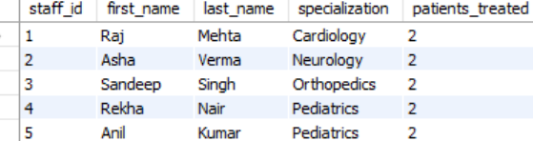

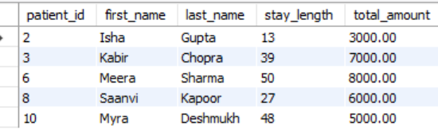

Business Requirements
1. Patient Visits (last 6 months)
5. Rooms and occupancy
2. Doctors with specialization and patients count
6. Medical history of a patient
3. Appointments for Dr. Mehta on 2024-03-15
7. Emergency visits last month
4. Patients admitted > 10 days + total bill
8. Patients prescribed Amoxicillin (last 3 months)
Go to Contents

Slide 10
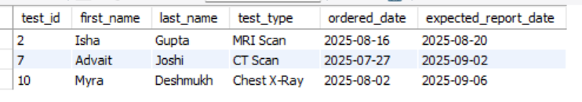







Business Requirements continued..
9. Pending medical test reports
13. Surgeries in last 6 months (by type)
14. Prescriptions by a doctor (date range)
10. Department with most admissions (last year)
11. Patients visiting multiple doctors for same illness
15. Most common illness
16. Revenue report
12. Staff in Cardiology dept with shift timings
Go to Contents

Slide 11
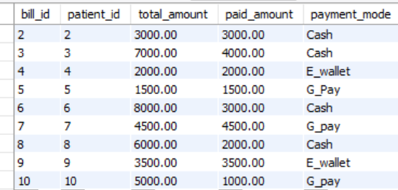
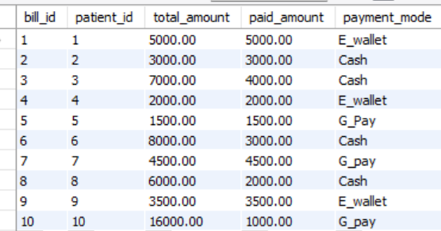
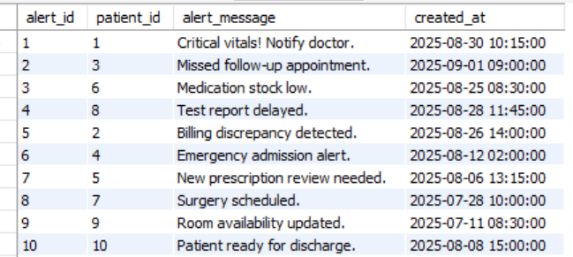
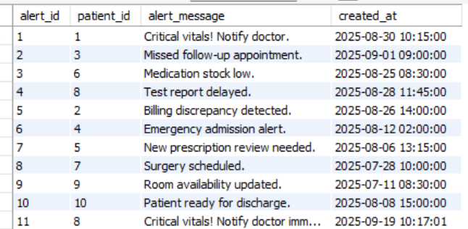
Business Requirements continued..
17. Update bill on discharge (Trigger)
Before update
After update
18. Notify doctors on critical vitals
Before insert on vitals
After insert on vitals
Go to Contents

Slide 12
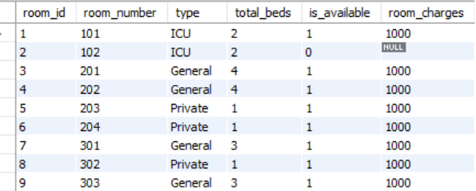
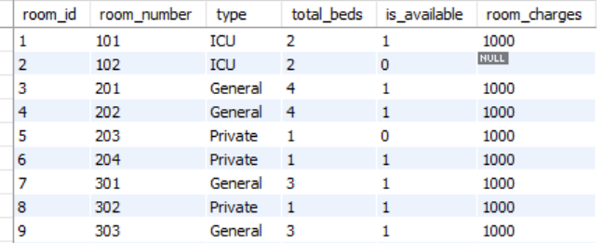
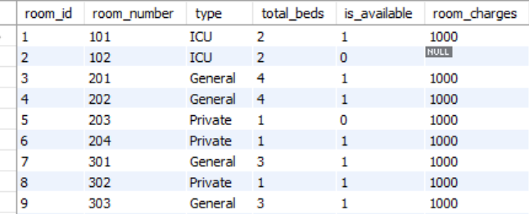
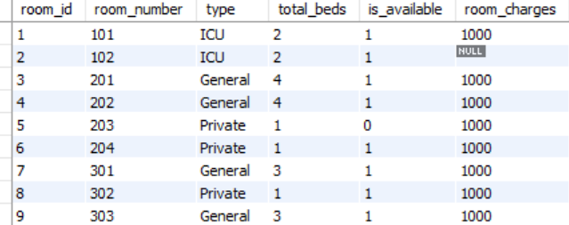
Business Requirements continued..
19. Prevent duplicate patient records
20. Update room availability on admit/discharge
Before insert on admissions
After insert on admissions
Go to Contents
Before update on admissions
After update on admissions

Slide 13
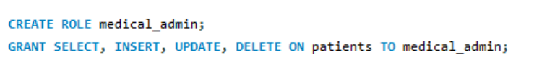
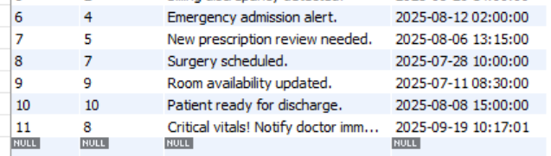
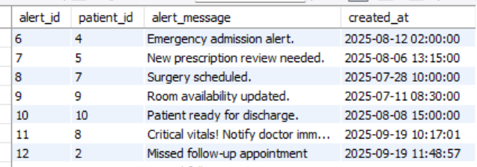
Business Requirements continued..
21. Verify medicine availability before prescribing
22. Role-based security (only authorized staff can update records)
23. Alert for missed follow-ups
Before insert into appointments
After insert into appointments
Go to Contents

Slide 14
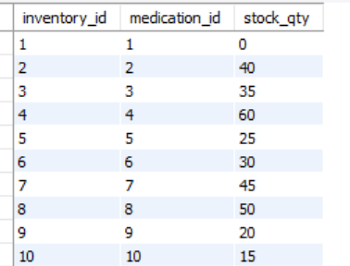
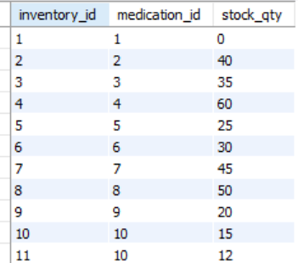
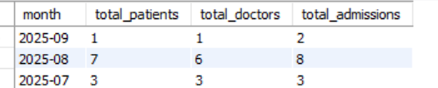
Business Requirements continued..
24. Update inventory on supply received
Before insert on supply_orders
After insert on supply_orders
25. Monthly summary of patient admissions, treatments, and medical trends.
Go to Contents

Slide 15
Business Requirements continued..
26. Final bill auto-updated on discharge
Before update
After update
Go to Contents

Slide 16
Conclusion
Centralizes patient, doctor, appointment, billing & pharmacy data.
Minimizes errors and duplication, improves efficiency.
Automates room allocation, inventory, and alerts.
Ensures data integrity, security & real-time access.
Provides reports & insights for better management.
Makes healthcare management more accurate, efficient & reliable.
Go to Contents

Slide 17
Future Scope
Telemedicine Integration – Enable remote doctor consultations via video calls.
Mobile Application – Provide patients and doctors with a mobile app for easy access.
AI & Machine Learning – Predict diseases, suggest treatments, optimize hospital resources.
IoT & Wearable Devices – Connect patient health data (heart rate, BP, glucose) directly to HMS.
Cloud Deployment – Allow scalable, anytime-anywhere access to hospital data.
Blockchain for Records – Secure patient data and enable safe sharing between hospitals.
Automated Chatbots – For appointment booking, FAQs, and patient assistance.
Insurance Integration – Direct claim processing with health insurance providers.
Multi-Hospital Networking – Centralized system for chain hospitals and health networks.
Go to Contents

Slide 18
THANK YOU

